Slide 1
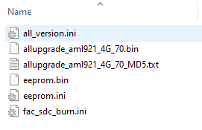
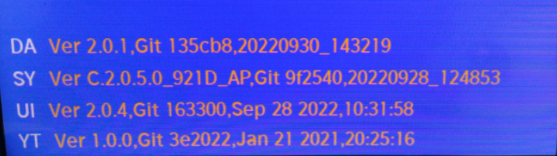
Software Update Guideline for Coolite2.0
1-Take copy all 6 files in USB directly, plug in the USB disk to the TV USB port. AC turn off TV ,and AC turn on TV , after about 5 secs, The LED light start blink and wait the upgrading process to the end LED light stop blink and the TV will reboot automatically.
2-Press “ Source->Left->Right->Left->Right ” buttons in sequence to open Factory Menu, and factory menu will appears, and check software version you updated.

Slide 2
Another way to update Software
Software Update Guideline for Coolite2.0
1-Take copy all 6 files in USB directly, plug in the USB disk to the TV USB port.
2. Press “HOME” button of Remote control and move focus to Setting, Press “OK” to open
Setting page .
3. Move focus to Setup option, Press “OK” to open Setup page .

Slide 3
4.Move focus to Advanced Option , Press “OK” to open Advanced Option page .
5.Move focus to Software Update(USB) Option , Press “OK” to confirm, Select “Yes” to start .
->Software Update(USB)

Slide 4
6. Waiting the upgrading to the end , the TV will reboot automatically .

