Slide 1
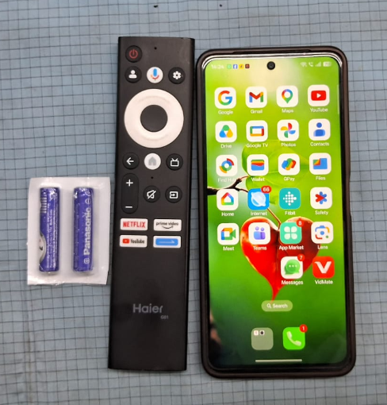
Remote Control OTA update Process Flow Chart.
Required Accessories for OTA Update
The following accessories are required to perform the OTA update using the Google Remote:
1.Google Remote (as shown in the reference image)
2.Two AAA Batteries (for the Google Remote)
3.Mobile Phone with internet connectivity
Please ensure that all the above accessories are available before starting the OTA update process.

Slide 2
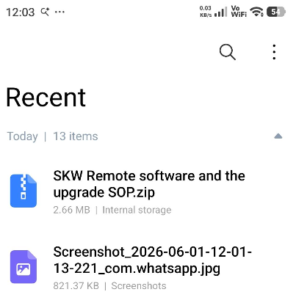
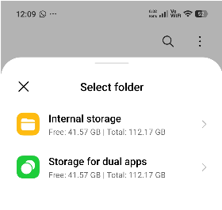
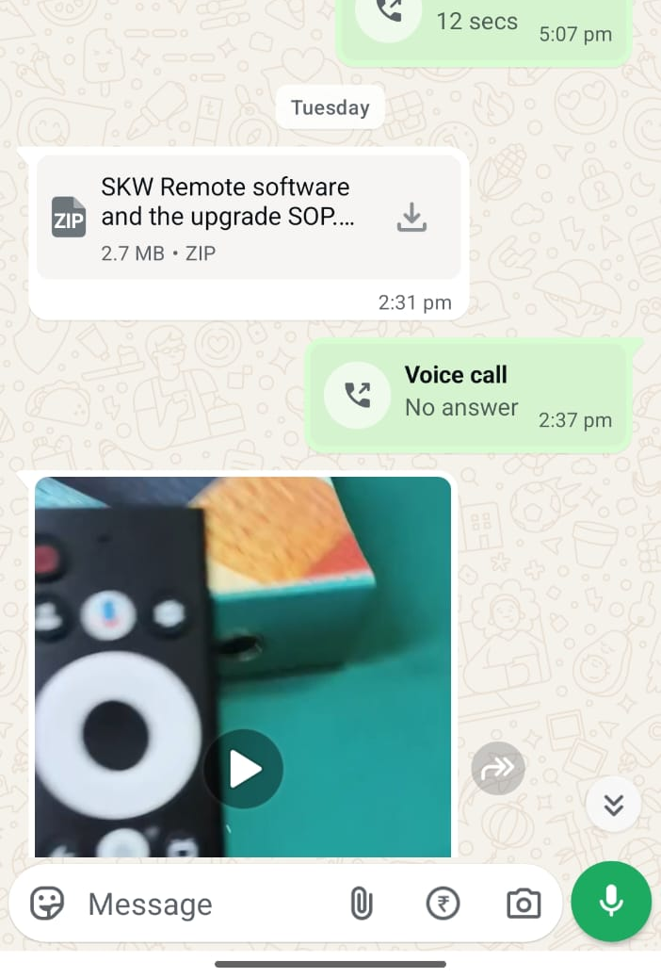
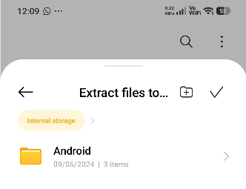

Remote Control OTA update Process Flow Chart.
This is ZIP file in which three links are attached. So firstly download this file in your mobile phone from WhatsApp.
Go into the download recent download or google file then Tap on the highlighted zip file
Select Internal Storage file
Tap on the Extract file to internal Storage file.
View the extracting file.

Slide 3
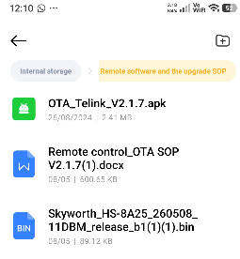
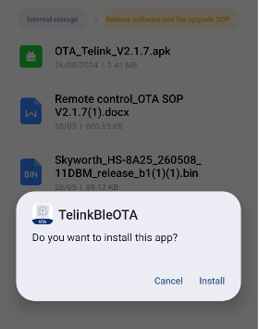
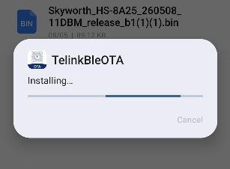

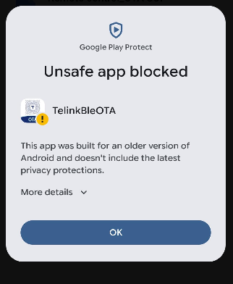
Remote Control OTA update Process Flow Chart.
Open this file in Internal Storage file.
Three links in this file.
1.Tap on the (OTA_Telink_V2.1.7.apk)
1.Select the Install option.
This APK file some restrictions. So choose the more details option.

Slide 4
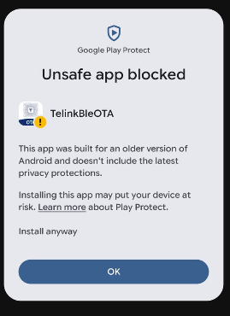
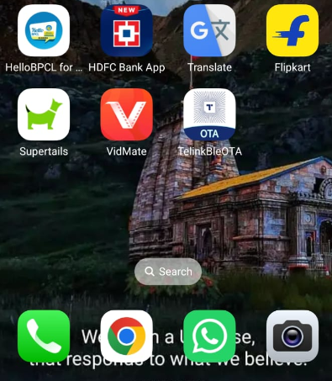
Remote Control OTA update Process Flow Chart.
1.Select the Install anyway option.
2.App is installed showed in next pic.
After Install upgrade apk on the mobile phone tools (OTA_Telink_V2.1.7.apk); the icon after installation is as shown below:

Slide 5
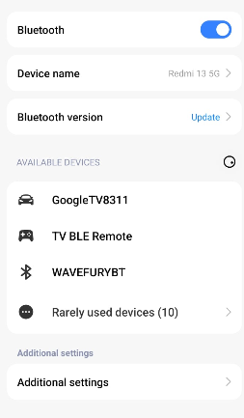
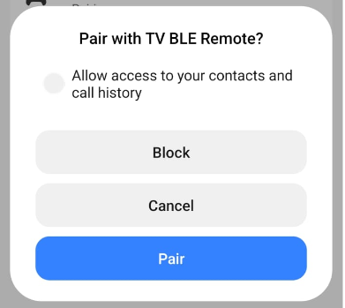
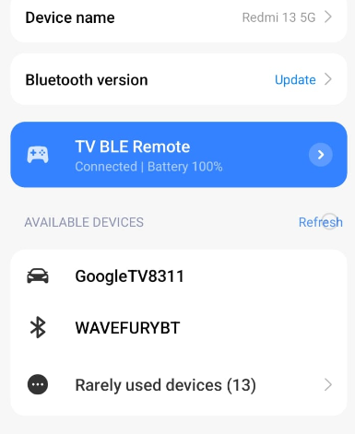
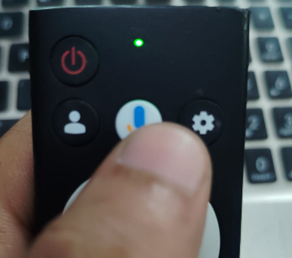
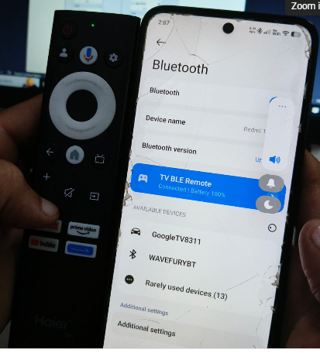
Remote Control OTA update Process Flow Chart.
Open Bluetooth on the phone, and Press the google assistant button then showing green light.
1.Select TV BLE Remote showing in highlighted.
1.Select the Pair option.
2.Remote controller connected successfully.
3.The remote controller pair and connect; as shown in pic.
Press the google assistant button then showing green light.

Slide 6
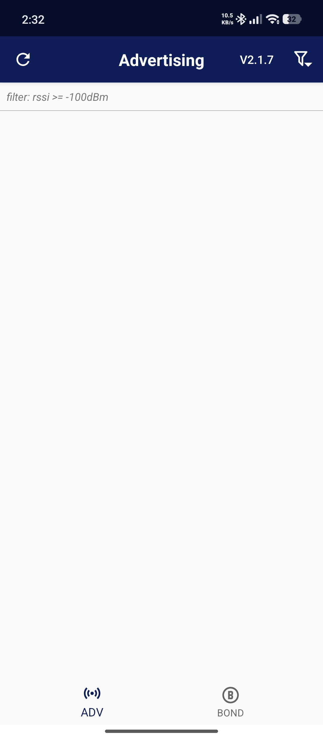
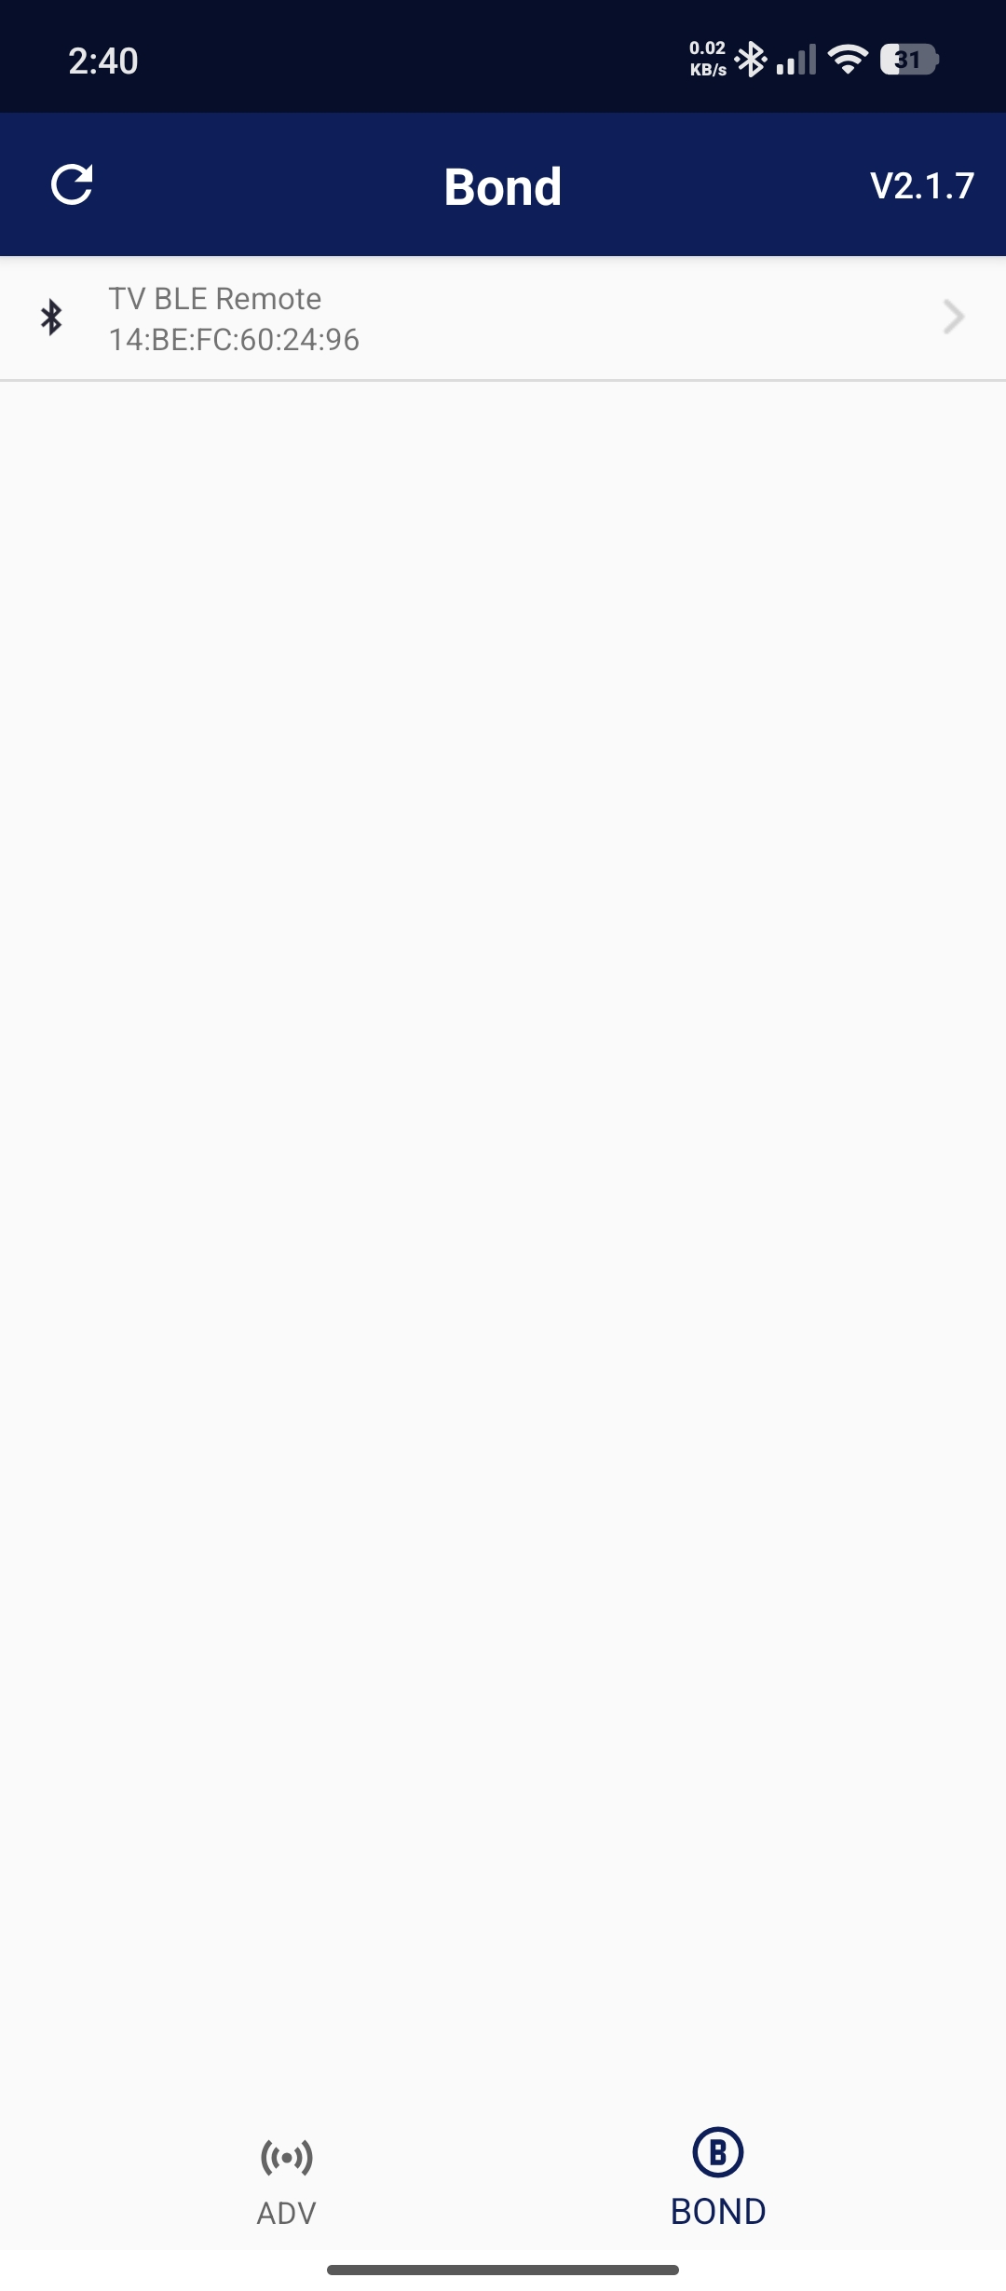
Remote Control OTA update Process Flow Chart.
，
1.Open the apk on the mobile phone tools (OTA_Telink_V2.1.7.apk); the icon after installation is as shown below
The Bluetooth devices connected to the current phone will be listed in the APK. Find the remote control. Tap the device to upgrade the OTA APK and connect it to the remote control.
Select the bond option.

Slide 7
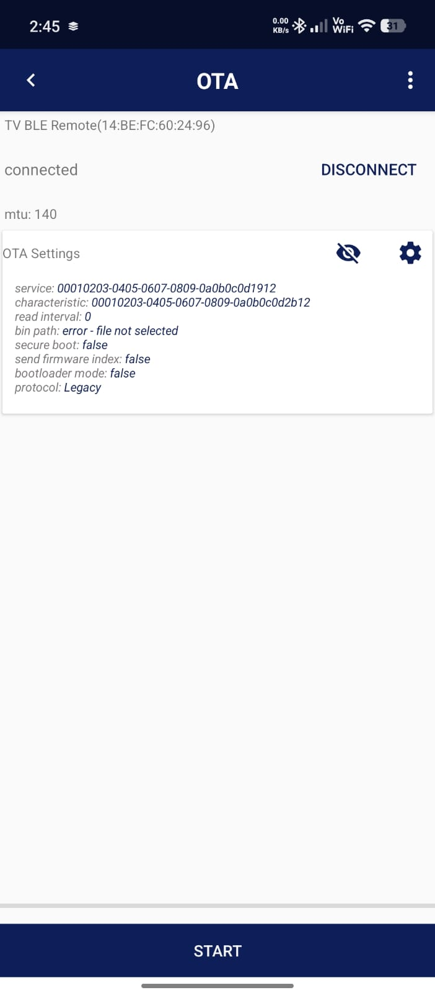
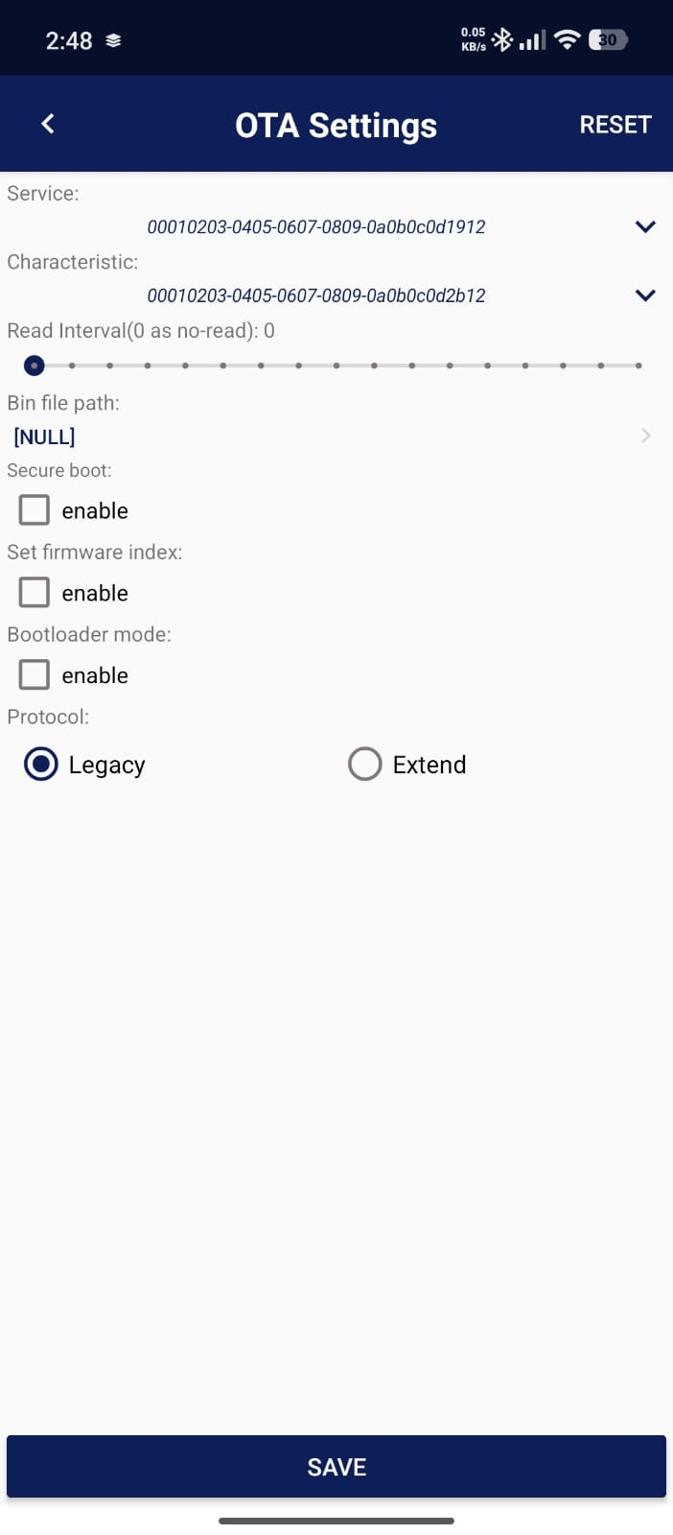
Remote Control OTA update Process Flow Chart.
After connected，In the upper right corner of the interface "DISCONNECT" it will be highlighted; then click the gear-shaped icon on the upper right to open the setting interface, as shown in the figure

Slide 8
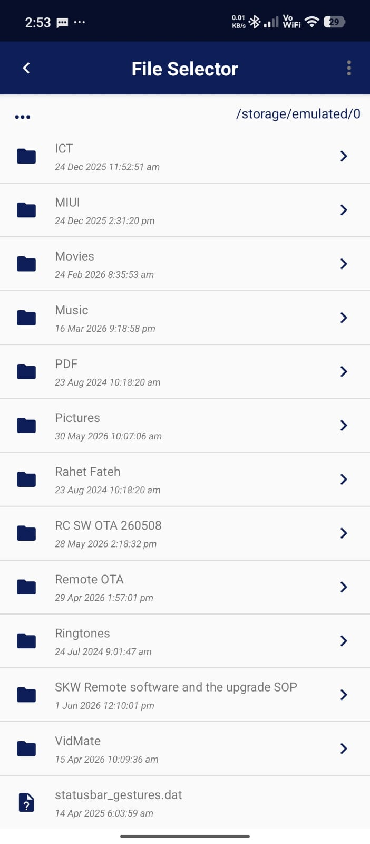
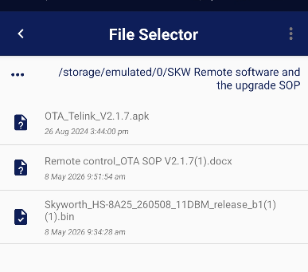
Remote Control OTA update Process Flow Chart.
1.Select the highlighted folder & open it.
2.After setting is opened, the following interface will be displayed, and then select the bin file to be upgraded. After selecting the upgrade file.
1.Click on the bin file path. Showing in highlighted

Slide 9
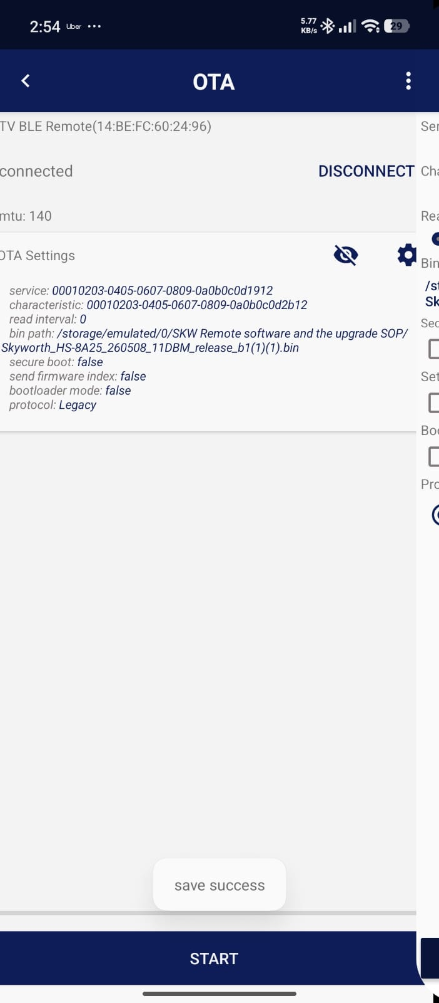
Remote Control OTA update Process Flow Chart.
the following interface will be displayed, and then select the bin file to be upgraded. After selecting the upgrade file, click Save below. "Save and exit this interface, as shown in the following figure：

Slide 10
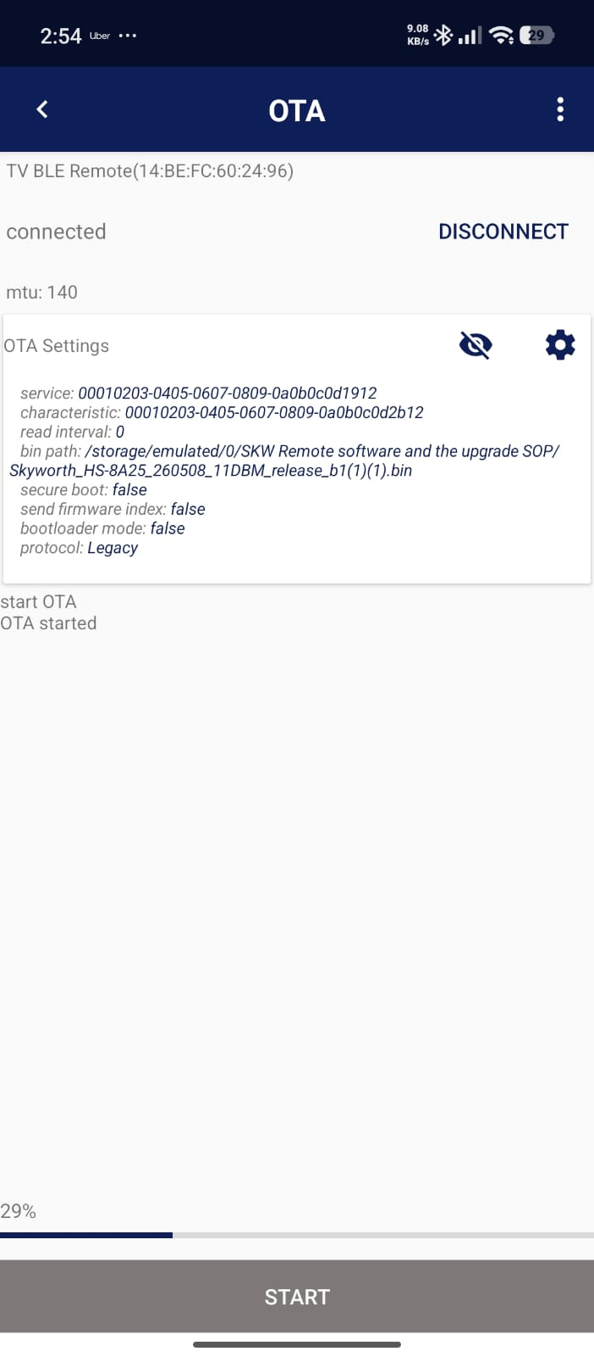
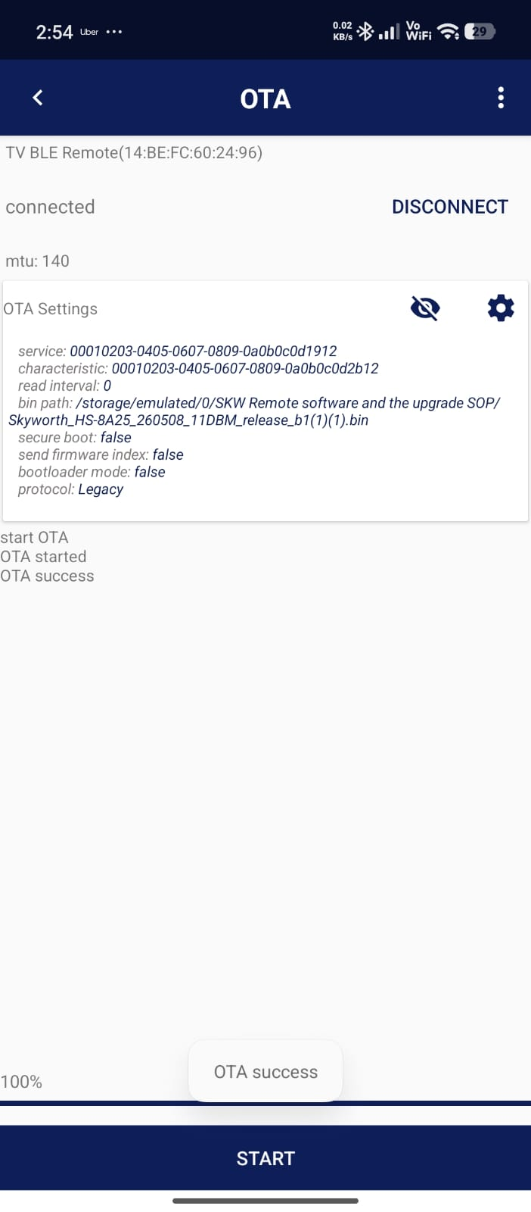
Remote Control OTA update Process Flow Chart.
After returning to the upgrade screen, click the "START" start the upgrade as shown in the following figure

Slide 11
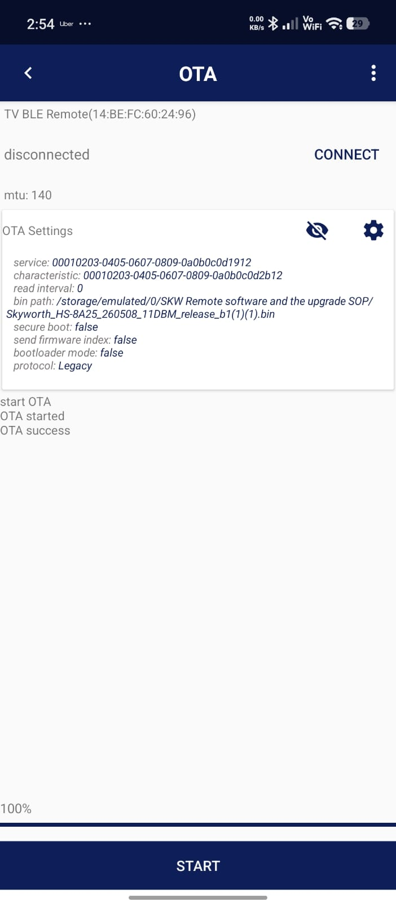
Remote Control OTA update Process Flow Chart.
After the upgrade is successful, the following figure is displayed: Remove the battery from the remote control, press several buttons at random to discharge the remote control quickly, and then power on the remote control again to ensure normal use. (After power on again, the remote controller may be connected back to the Bluetooth of the phone because the pairing information before the upgrade is saved. You can unpair the remote controller in the settings of the phone.)

